Slide 1
Using the Hoffman2 cluster
November 28 2017

Slide 2
What is Hoffman2?
UCLA’s supercomputing cluster
Largest and most powerful cluster in the UC system
Vital if you have huge data and/or heavy-duty computation
Managed and operated by the IDRE Research Technology Group
1,200+ 64-bit nodes and 13,340 cores, over 50TB of memory

Slide 3
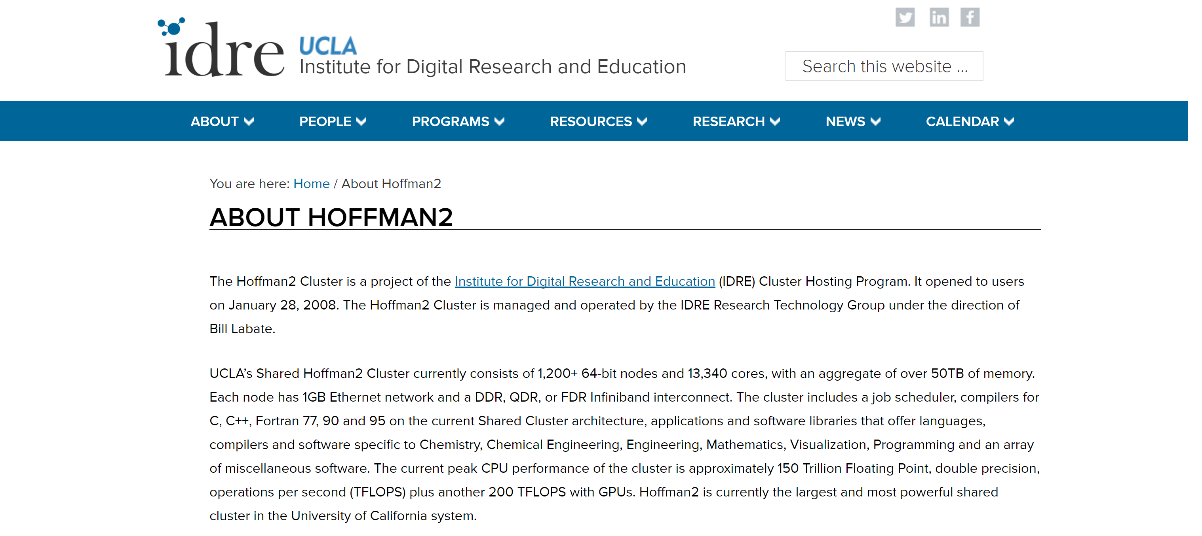
Website: https://idre.ucla.edu/hoffman2

Slide 4
How to get a Hoffman2 account
Need to register with UCLA IDRE (https://www.hoffman2.idre.ucla.edu/getting-started/)
Need a faculty sponsor (usually your advisor)
IDRE gives workshops fairly frequently on using Hoffman (check their website)

Slide 5
Connecting to Hoffman2
Unix, Linux, Mac users:
Use the ‘ssh’ command in the terminal to log in:
ssh login-id@hoffman2.idre.ucla.edu
Windows users
Can use an SSH client like “MobaXterm”, “PuTTY”, etc.
Can use remote desktop “NoMachine”
See Hoffman site for more details

Slide 6
Using Hoffman2 (basics)
Every user has a home directory with 20GB storage for general use
Type ‘myquota’ to see how much storage you have remaining
You also have more storage for temporary use
2TB in ‘/u/scratch’; keep for 7 days

Slide 7
Using Hoffman2 (basics)
When you log onto Hoffman2, you are assigned a ‘login node’ where you can maneuver around, organize files, etc.
Do not do computations on the login node (you will get some angry emails from IDRE)!
You can request an interactive session using the ‘qrsh’ command to request a compute node for interactive use (example soon).
Alternatively, whenever you submit a job to the scheduler, it is automatically executed on the compute nodes (example soon).

Slide 8
Using R on Hoffman2
Different version of R are available on Hoffman2
Type ‘module avail R’ to see which versions are available
To load a specific version (say 3.2.1), type ‘module load R/3.2.1’. Otherwise, typing ‘module load R’ will load the default version of R (currently 3.2.3).
Type ‘R’ into the terminal to open R (remember, don’t do computations in the login nodes)!

Slide 9
Using Python on Hoffman2
Different version of Python are available on Hoffman2
Type ‘module avail python ’ to see which versions are available
Type ‘python’ into the terminal to open python.

Slide 10
Interactive sessions
Useful for doing more intensive computations
To request a compute node for interactive use, use the ‘qrsh’ command:
qrsh -l h_rt=8:00:00,h_data=4G
h_rt: Requested running time (8 hours).
h_data: Requested memory (4GB).
“Any job, started in an interactive session, attempting to use more memory than what had been requested with h_data will be automatically terminated by the scheduler.”

Slide 11
Submitting jobs
Very useful for heavy computations
To submit a job to Hoffman2, use the ‘qsub’ command:
qsub -N job1 -l h_data=8G,h_rt=23:00:00 -m bea thejob.sh
-N job1: Name the job ‘job1’. Can see the name when you type ‘myjobs’
-m bea: Define mailing rules. Email me when job ‘b’egins, ‘e’nds, and if the job is ‘a’borted

Slide 12
Submitting jobs
R Example
Say you have an R script, ‘example.R’, that you want to submit
Make a shell script, say ‘submit_r_job.sh’, with the following text:
#!/bin/bash
. /u/local/Modules/default/init/modules.sh
module load R
R CMD BATCH ~/toy_example/example_r_job.R
2. Submit this shell script to Hoffman2:
qsub -l h_data=4G,h_rt=1:00:00 submit_r_job.sh

